Slide 1

WELCOME TO MY
PRESENTATION
Presented by
Bashir Ahammed
Chief Instructor (RAC)
Pabna Polytechnic Institute
Contact No: 01722845953
email: engr.bashir34@gmail.com

Slide 2
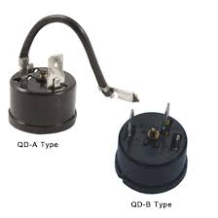
Link to the the Previous Session
Test Overload Protector of a Refrigerator

Slide 3
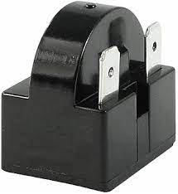
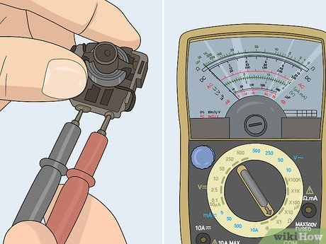
Learning Outcome
At the end of the session the learner will be able to perform test Relay of a Refrigerator within 10 minutes as per industry standard.

Slide 4
Structure & Stimulation

Slide 5
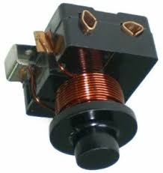
Discussion
Definition of Relay
The relay is the device that opens or closes the contacts to cause the operation of the other electric control. It detects the intolerable or undesirable condition with an assigned area and gives the commands to the circuit breaker to disconnect the affected area. Thus protects the system from damage.
Reason of faults Relay:
Over voltage and over Current

Slide 6
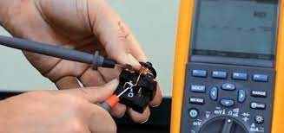
Tools & Equipment

Slide 7

Personal Protective Equipment

Slide 8
Demonstration
Working Procedures:
Wear appropriate PPE for the Job.
Select measuring instruments
AVO meter as per specification.
Select Relay as per specification.
Select AVO meter ohm scale.
Connect two probe relay 2 point.
If show continuity that’s means Relay
condition is good.
Clean and restore all tools & materials.
Clean the work place.

Slide 9
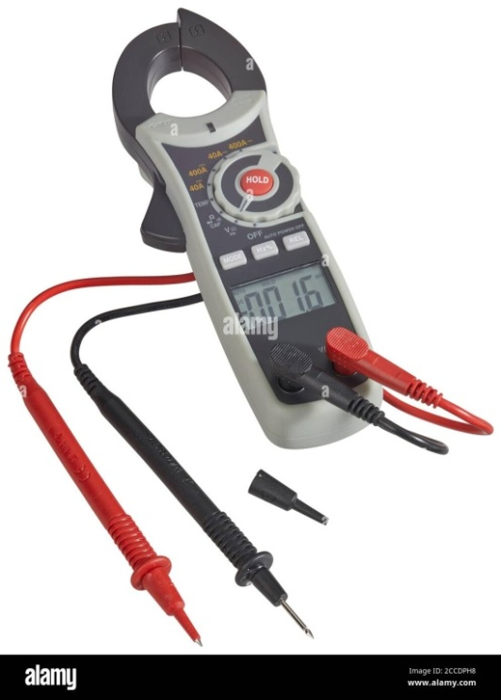
Review and Feedback

Slide 10
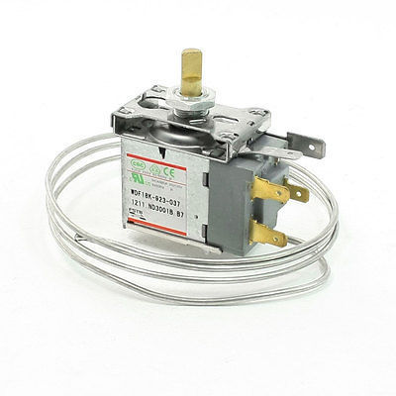
Next Session
In the next session you will learn how to Test Thermostat switch of Refrigerators within 10 minutes as per industry standard.
Thermostat

Slide 11

THANK YOU

